Slide 1


Banking Management System
Department of Electrical & Computer Engineering
Fall 2022 - 2023
in
Programming For Engineers (Comp 215)
Presented to:
Eng. Hadi Al Mubasher
Done by:
Jana Moslemani - 202304315 Omar Omar - 202102211
Dima Abdallah - 202101973 Zaher Ismail - 202205114

Slide 2
Table of Content
Program Description
User Access
Importance & Advantages
Objectives
01
10
11
100
101
110
111
Topics Covered
Future Purposes
Output & Functions

Slide 3
Program Description
Our program code is related to a bank management system.
This means that the user, from all over the world, can access the bank services and make transactions.

Slide 4
Objectives
Eliminate paperwork in a bank.
Record every transaction in a computerized system to reduce problems such as “record file missing”.
Keep track of all type of accounts in a systematic manner.
Make a proper application that is user friendly, and less time consuming.

Slide 5
User Access
Home Page
Login
Register
Transactions
Withdrawls
Deposits
Our user will be able to access :

Slide 6
Importance & Advantages
Saves time.
Easy to use.
Facilitates classifying data.
Global Reach.
24/7 Availability.
Secure Transactions.

Slide 7

Topics Covered
Conditional if statement
Random Number Generator
For loops
Lists
The topics covered include:
Functions
Arrays
Mathematical Operations
Libraries
Nested if loop

Slide 8
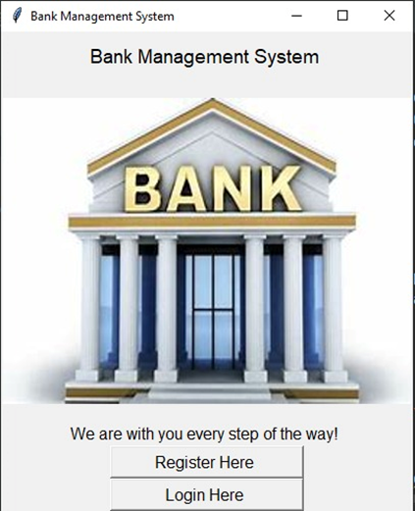
Output & Functions : Main Screen

Slide 9
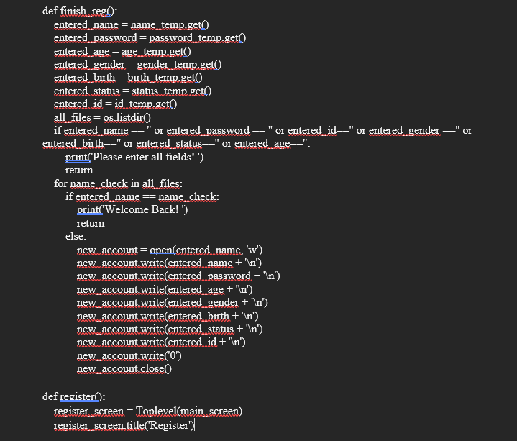
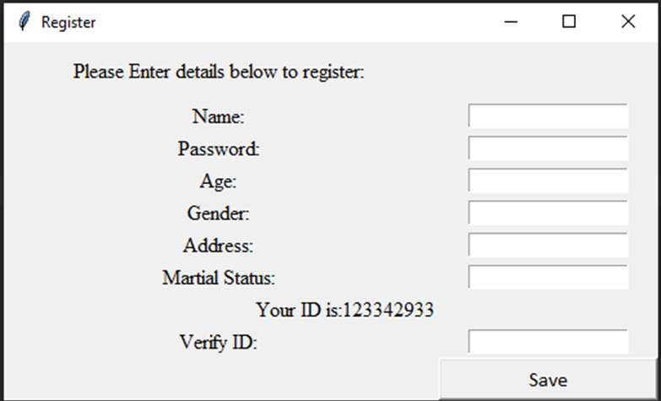
Output & Functions : Register
Asks the user to enter details in order to start his/her bank account.
Information is compulsory to differentiate between multiple users that may have some common information and are stored in a file to be accessed later and edited.

Slide 10
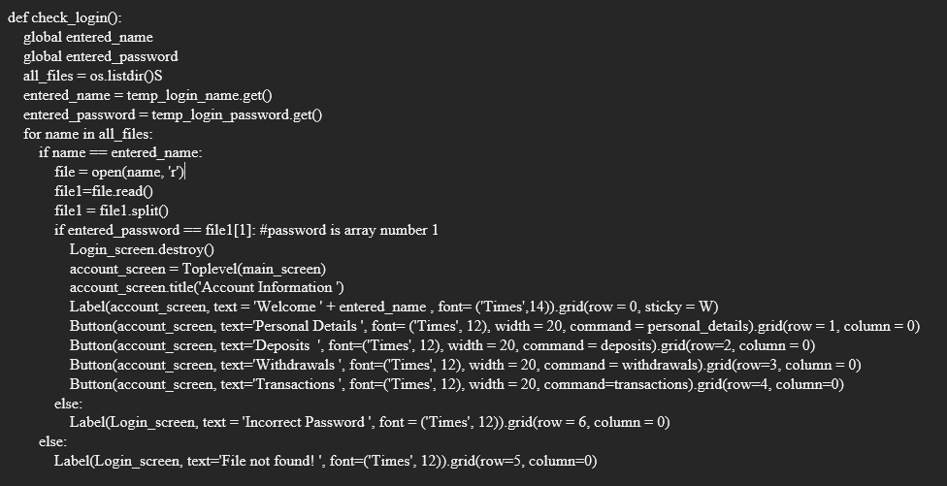
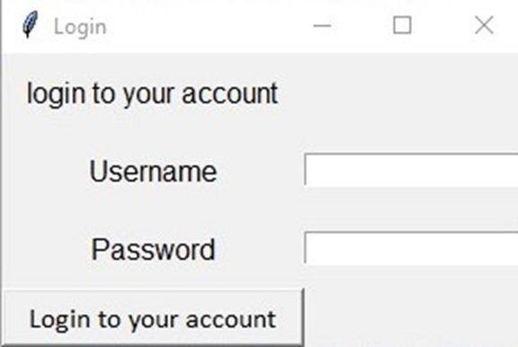
Output & Functions : Login
Login function asks the user to enter his/her name and the password they have created.
The program checks all the files found in the directory, if the file has the same name and password, then a new login page will pop up allowing the user to access his personal information, deposit or withdraw a certain amount.

Slide 11
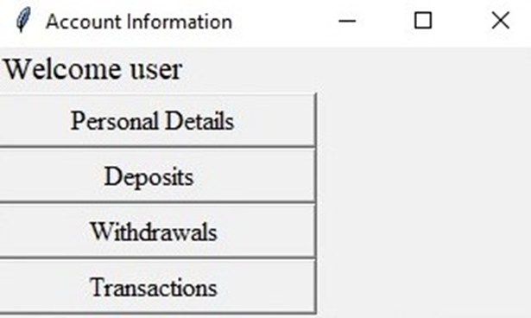
Output & Functions : Account Information

Slide 12
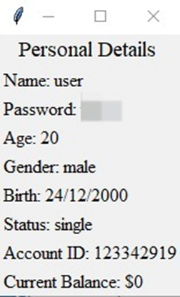
Output & Functions : Personal Details

Slide 13
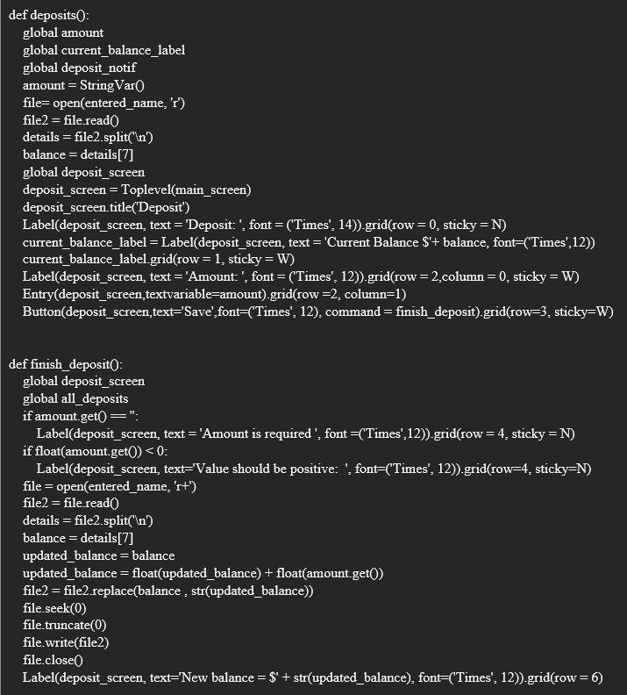
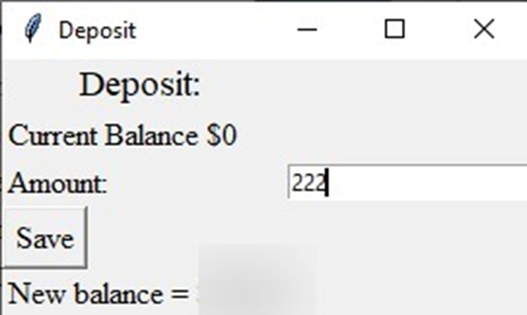
Output & Functions : Deposit
Deposit function asks the user to enter a certain amount to deposit into his/her account and adds the value to the current balance, updating the new value in the file.

Slide 14
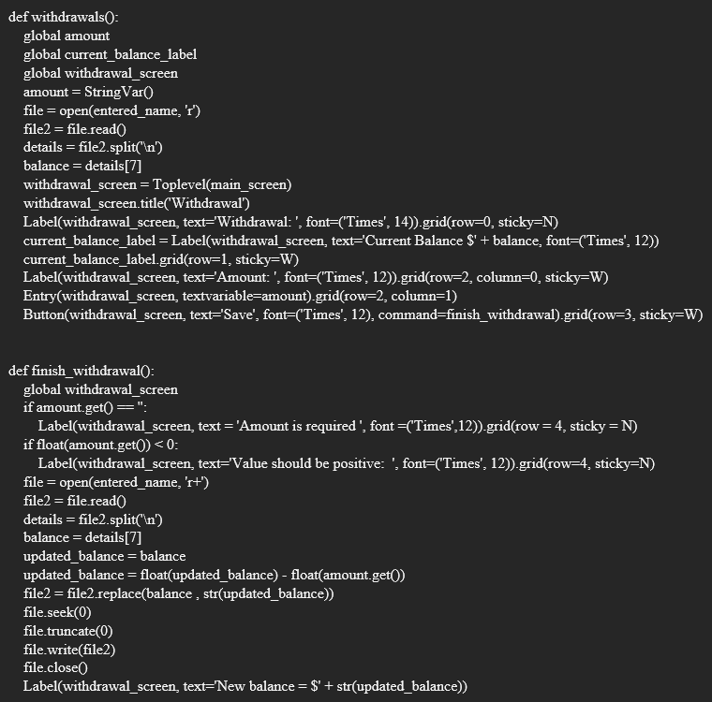
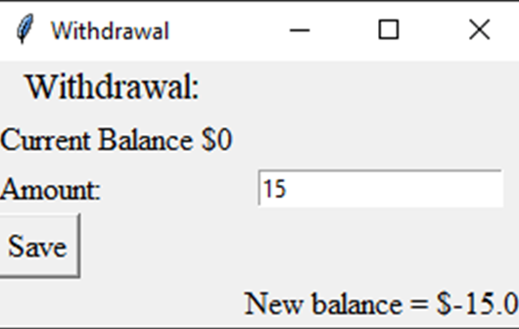
Output & Functions : Withdrawl
By asking the user to input a specific amount to withdrawl into his or her account, the withdrawl function updates the file with the new value and deducts the value from the current balance.

Slide 15
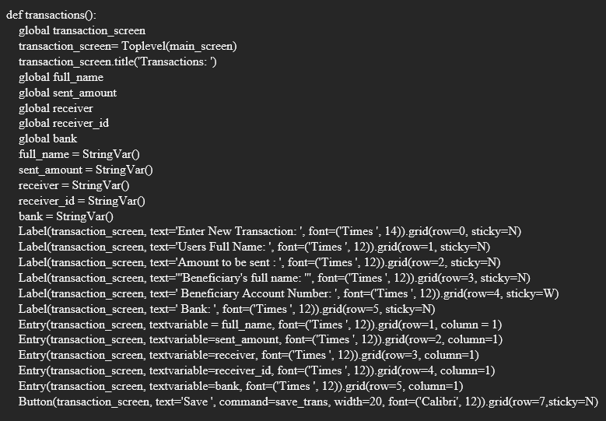
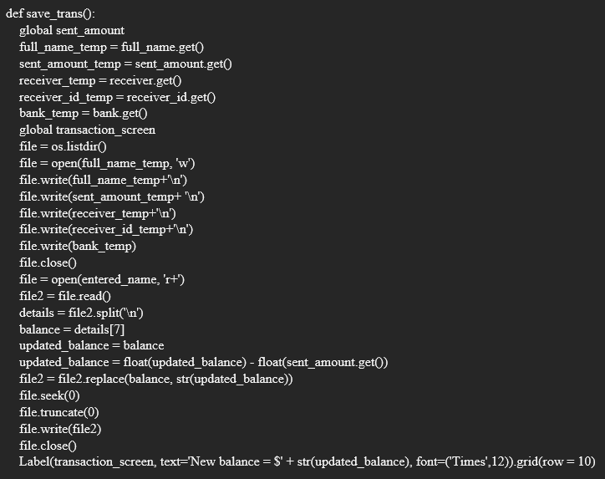
Functions : Transactions
The transactions' function withdraws the amount of money requested by the user and sends it to the beneficiary’s account after entering the account name and number in addition to the bank’s name.

Slide 16
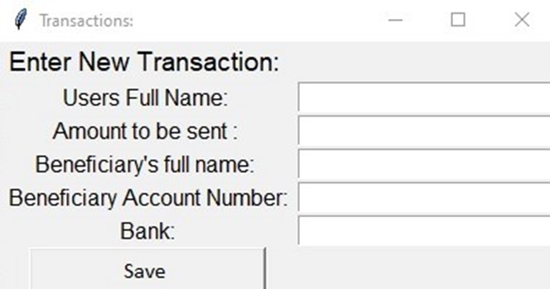
Functions : Transactions

Slide 17
Future Purposes
Can be further enhanced for cyber security banking.
Can be used as a global system of data collection.
Can be reconstructed into an app for personal use.

Slide 18

Thank you!

